Slide 1
Week 8 Presentation
Wednesday, October 16, 2019
ATLAS Data analyst team:
Smruthi Iyengar
Kagen Jet Quiballo
Hanqing Wang
Yuxin Wang
Notes:
Greets, ladies and gentlemen. Welcome to our week 6 presentation. We are ATLAS Data Mining team. [self intro based on the list, name, major, title] The objective of this project is to study what impacts students’ matriculation from a financial perspectives.

Slide 2
Introduction
What we did before: by residency and college
Different types of non-continuing students
Students who drop out based on holds
New method to detect drop out students
Notes:
For this week, first we are going to talk about the overview dropout from fall 17 all the way to Sp19 semester by semester. Then, we are going to focus on the dropout rate based on specific categories, like dropout rate by different groups, by colleges, by hold and by residency. Thus, I will leave the stage to Kagen.

Slide 3
METHODS
UNDERGRADS
accurate & representative
accuracy
matched demographics within 0.5%
example
blanks in S18 →
look for refund during
active term (F17)
REFUND
for corresponding term
CREDIT HOURS
no blanks/0s → blanks/0s
blank (did not register)
0 (special case: internship, or registered and dropped)
Notes:
First talk about the methods → start with yellow, then blue, then green

Slide 4
UG DISCONTINUE: AT LEAST ONE SEMESTER
LAST WEEK
F17 | S18 | F18 | S19 | COUNT | REFUND TUITION
 | did not continue |  |  | 2,491 | 1,231
 |  | did not continue |  | 3,904 | 2,545
 |  |  | did not continue | 1,965 | 976
*overlap of 108 students in rows 1 & 3
Notes:
Start with total. Talk a little bit about each semester jump
Then the trend of spring to fall dropout

Slide 5
UG DISCONTINUE: “COMPLETE DROPOUT”
F17 | S18 | F18 | S19 | COUNT
 |  |  |  | 2,069
 |  |  |  | 3,643
 |  |  |  | 1,857
 |  |  |  | 10,724
Notes:
Start with total. Talk a little bit about each semester jump
Then the trend of spring to fall dropout

Slide 6
UG DISCONTINUE: SKIPPING SEMESTERS
F17 | S18 | F18 | S19 | COUNT
 | skip 1 |  |  | 375
 |  | skip 1 |  | 261
 | skip 2 |  |  | 47
Notes:
Start with total. Talk a little bit about each semester jump
Then the trend of spring to fall dropout

Slide 7
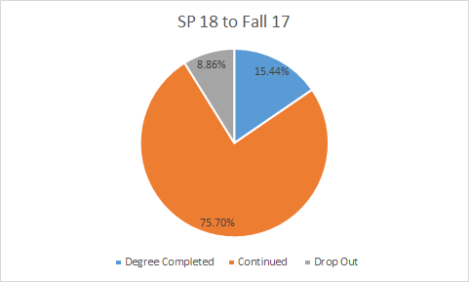
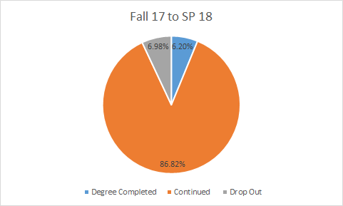
Undergraduate’s Drop out
Fall 2017: 18,957
Spring 2018: 17,763

Slide 8
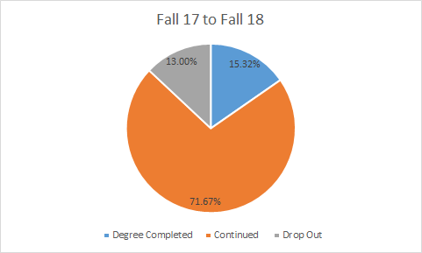
Undergraduate’s Drop out
 | Fall 17 to SP 18 | SP 18 to Fall 17 | Fall 17 to Fall 18
Drop Out Rate | 7.45% | 10.47% | 15.35%

Slide 9
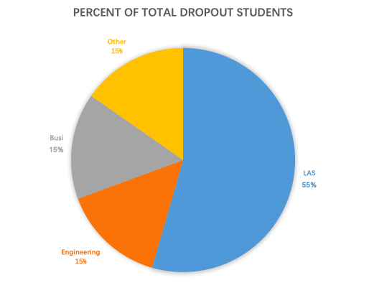
By college
Fall 2017 to Fall 2018
Liberal Art & Science: 55%
Business College: 15%
Engineering: 15%
Notes:
For all students who dropout from fall2017 to fall2018, 55% are LAS students, 15% are from business college, 15% are from engineering college, and 15% are from other colleges.

Slide 10
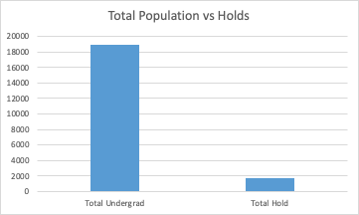
Percent of Undergrads that had a Hold (Fall 2017)
1655 undergraduates had a hold in Fall 2017
9 percent of total undergrad

Slide 11
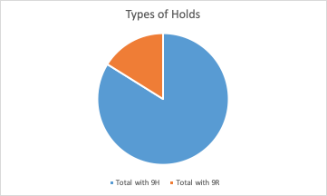
Distribution of the Types of Holds
A Majority 1,388 (84%) of the holds are 9H
16%
84%

Slide 12
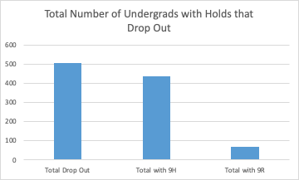
Holds That Lead to Drop Outs
504 people did not continue from Fall 2017 to Fall 2018 and had a hold on their account.
87 percent of these students had a 9H Hold

Slide 13
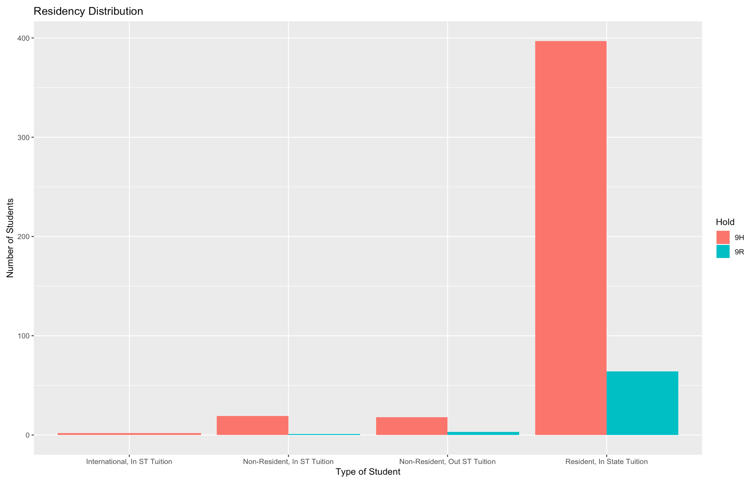
By Residency
91% are In state Students

Slide 14
Conclusion
Most students who don’t continue do so from S18 to F18.
Students tend to drop out after spring semester. First year Freshmen has highest dropout rate.
LAS, Engineering, and Business have similar dropout rate from F17 to F18
Holds that lead to dropout- Most that dropout are instate freshmen.

Slide 15
Thank you for listening!
Questions?

